Slide 1
1
PAPER REVIEW
A Deep Analysis of Brain Tumor Detection from MR Images Using Deep Learning Networks
Course: Applied Data Science Submitted By: ADNAN AL SAYEED SIHAB
ID: 22141026

Slide 2
Table of contents
01
02
03
04
05
06
2
ABSTRACT OVERVIEW
METHODOLOGY
DATASET
RESULT
DATA PREPROCESSING
CONCLUSION

Slide 3
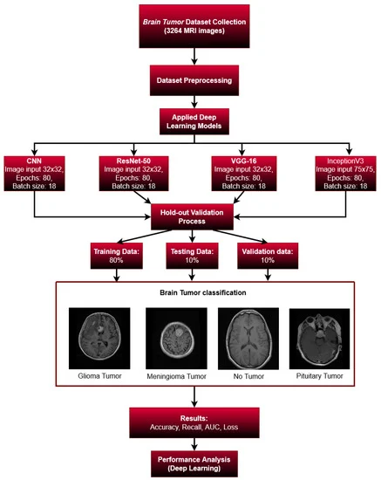
3
ABSTRACT OVERVIEW
The paper presents a deep learning model for brain tumour detection using magnetic resonance imaging (MRI) images. The authors propose a convolutional neural network (CNN) architecture for efficient brain tumour detection and compare it with transfer learning models such as ResNet-50, VGG16, and Inception V3. The proposed model achieved an accuracy of 93.3%, an AUC of 98.43%, a recall of 91.13%, and a loss of 0.25.

Slide 4
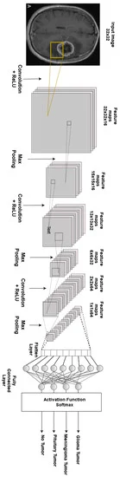
4
METHODOLOGY
The authors collected a dataset of 3264 MRI brain tumour images and preprocessed them by normalising and applying Gaussian and Laplacian filters. They split the dataset into training, testing, and validation sets and used a holdout validation method to evaluate the model's performance. The authors proposed a CNN architecture with a total of 16 convolutional layers and a 3 by 3 receptive field. They also used a dropout of 0.5 with a ReLU activation function.

Slide 5
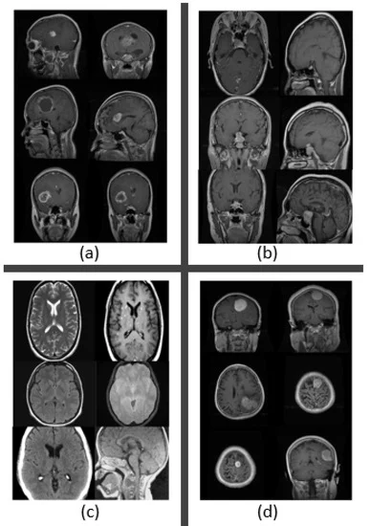
5
DATASET
The dataset consisted of 3264 MRI brain tumour images, with 80% used for training, 10% for testing, and 10% for validation. The dataset was split into four categories: glioma tumours, meningioma tumours, no tumour, and pituitary tumours.

Slide 6
6
DATA PREPROCESSING
The authors preprocessed the dataset by normalising the images and applying Gaussian and Laplacian filters to reduce noise and enhance the quality of the images. They also applied data augmentation by mirroring the images and applying rotation, width and height shifting, and zooming to increase the size of the dataset.

Slide 7
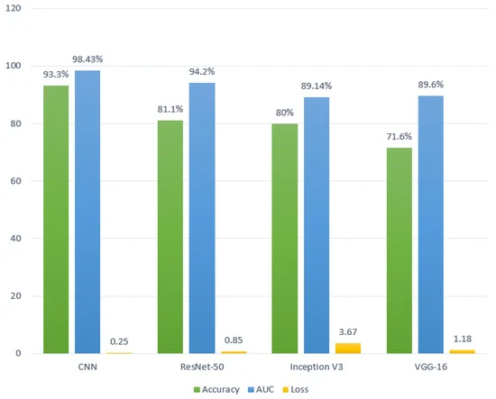
7
The authors trained the CNN model on the training set and evaluated its performance on the testing set. The model achieved an accuracy of 93.3%, an AUC of 98.43%, a recall of 91.13%, and a loss of 0.25.
RESULT

Slide 8
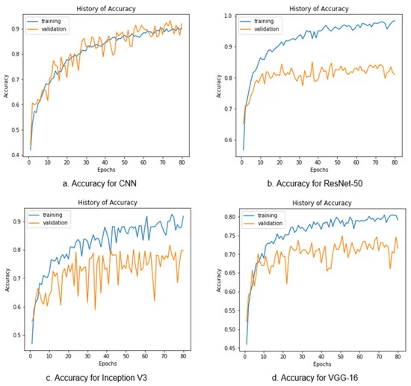
8
RESULT COMPARISON
The authors also compared the performance of the proposed CNN model with transfer learning models such as ResNet-50, VGG16, and Inception V3. The CNN model outperformed the other models in terms of accuracy, AUC, and recall.

Slide 9
9
CONCLUSION
The authors contributed a novel CNN architecture for the early detection of brain tumours from MRI images.
The model achieved an accuracy of 93.3%, an AUC of 98.43%, a recall of 91.13%, and a loss of 0.25.
They also proposed a new preprocessing technique for MRI images that improves the performance of the CNN model and achieved better results than existing transfer learning models on large dataset

Slide 10
10
Reference
Mahmud, M. I., Mamun, M., & Abdelgawad, A. (2023). A Deep Analysis of Brain Tumor Detection from MR Images Using Deep Learning Networks. Algorithms, 16(4), 176. MDPI AG. Retrieved from http://dx.doi.org/10.3390/a16040176

Slide 11
Thank You

